Slide 1
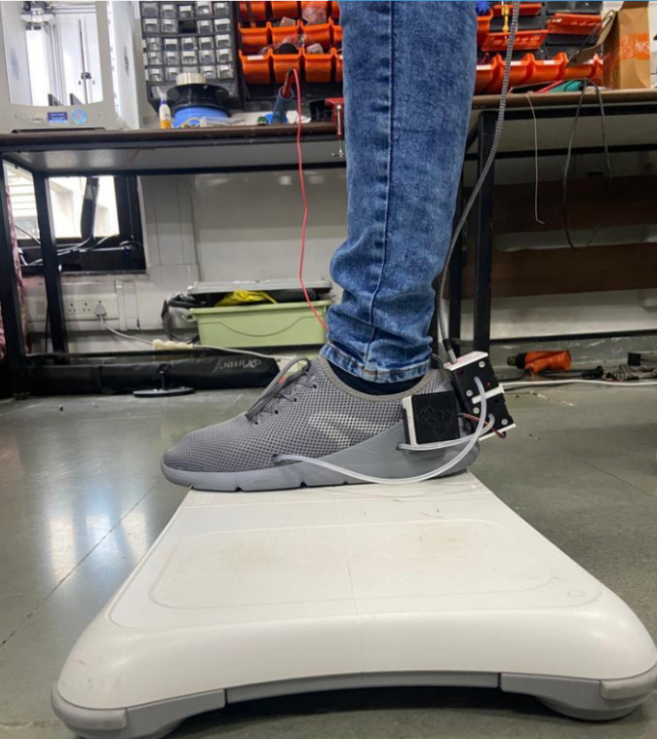

Smart Shoes
HCR Lab Meeting
Dhruv Thakkar

Slide 2
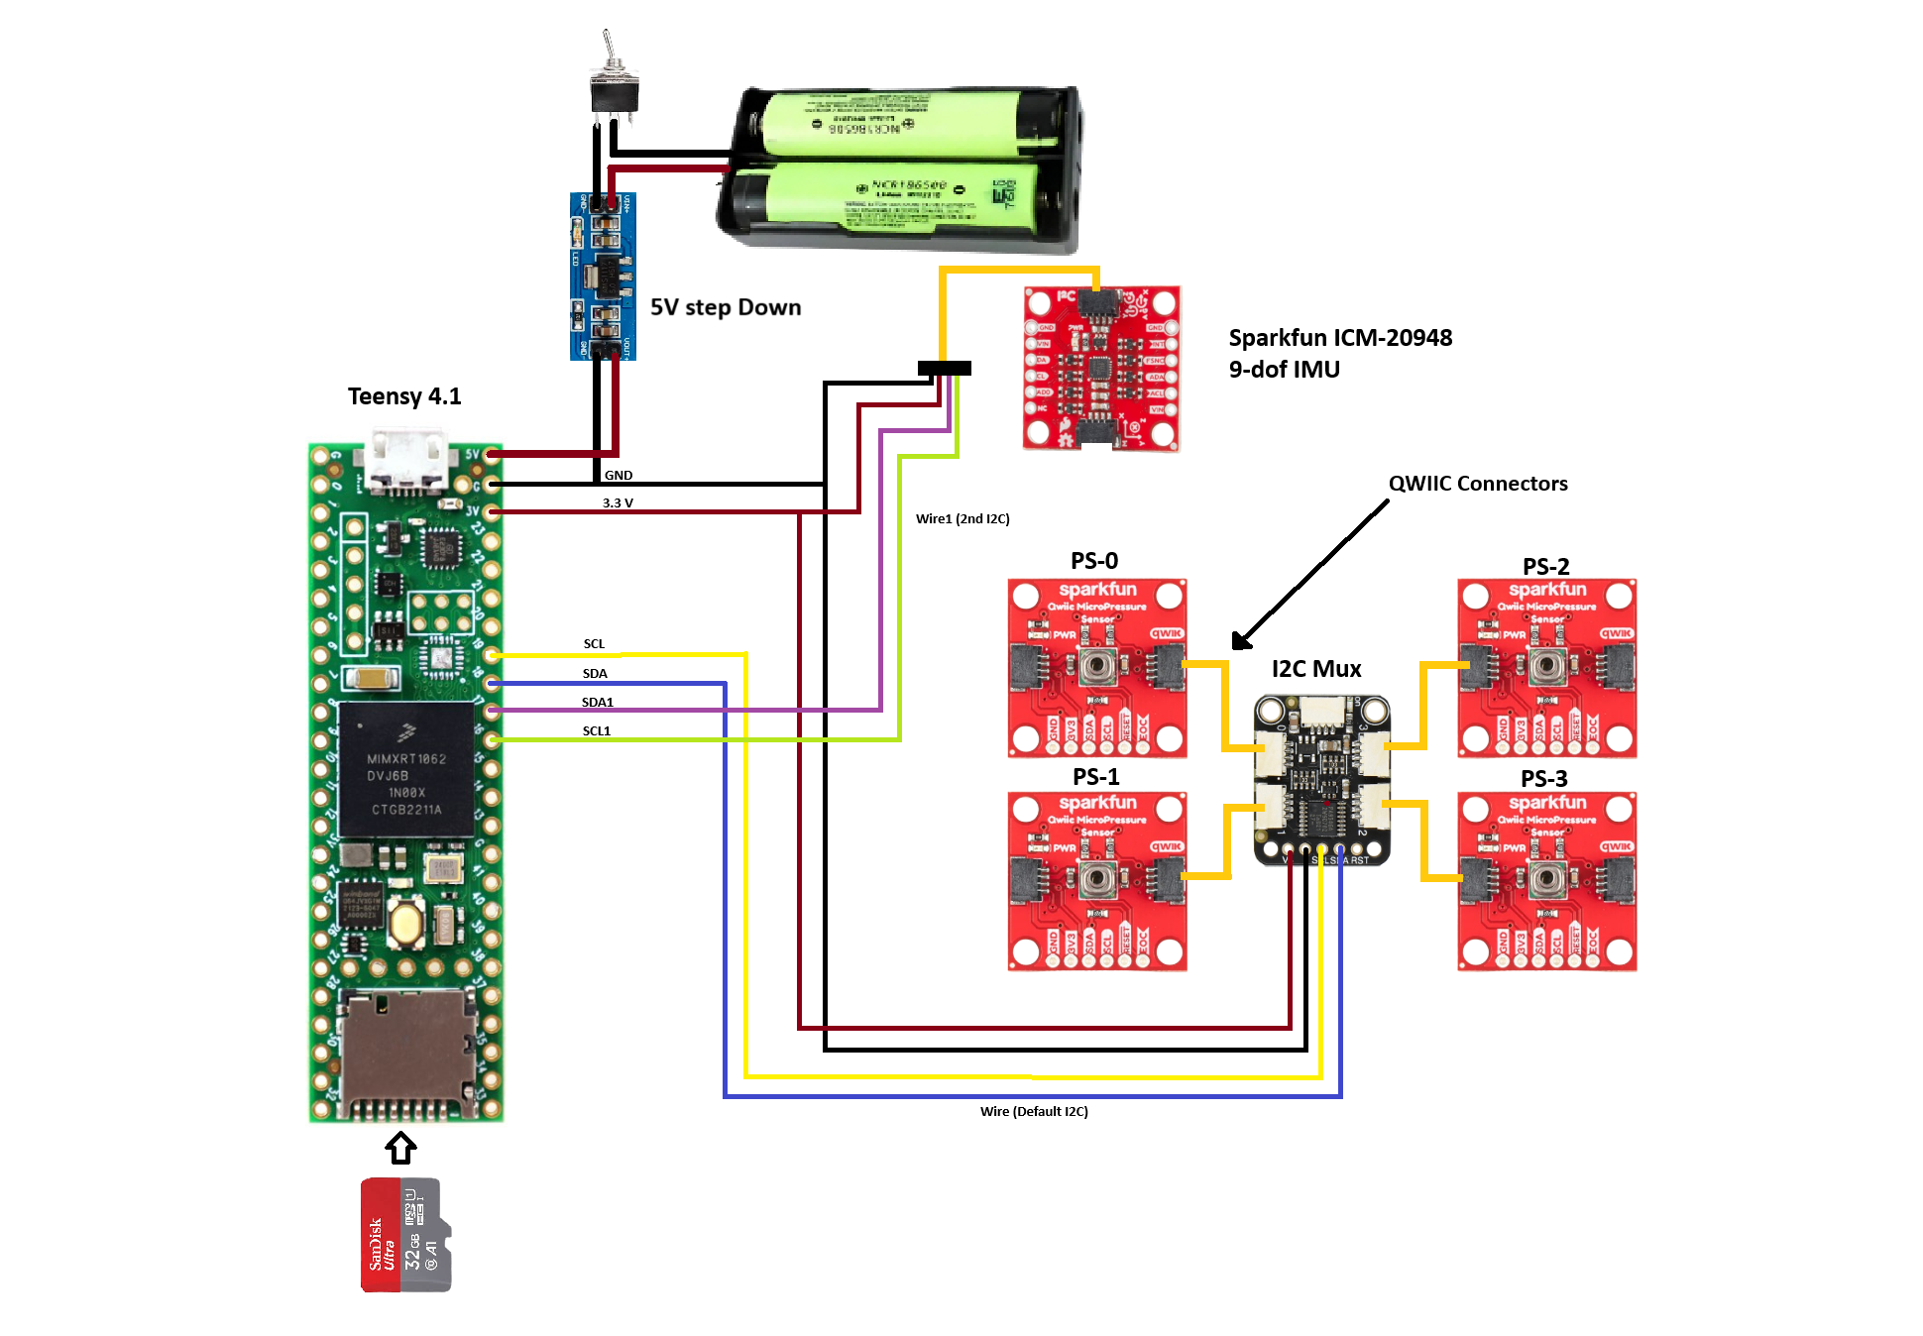
Progress Till Now
Circuit Diagram

Slide 3
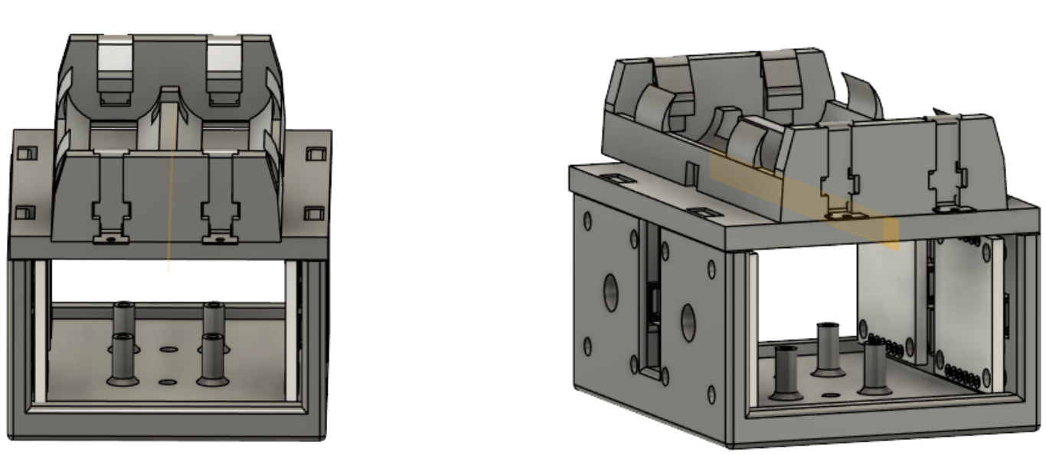
CAD

